Slide 1
Introduction to Graphical User Interfaces (GUIs)

Slide 2
Interactive Programs
“Classic” view of computer programs: transform inputs to outputs, stop
Event-driven programs: interactive, long-running
Servers interact with clients
Applications interact with user(s)
input
output
user
user
input events
output events
program

Slide 3
GUI Motivation
Interacting with a program
Program-Driven = Proactive
Statements execute in sequential, predetermined order
Typically use keyboard or file I/O, but program determines when that happens
Usually single-threaded
Event-Driven = Reactive
Program waits for user input to activate certain statements
Typically uses a GUI (Graphical User Interface)
Often multi-threaded

Slide 4
GUI Statics and GUI Dynamics
Statics: what’s drawn on the screen
Dynamics: user interactions
Components
buttons, labels, lists, sliders, menus, ...
Containers: components that contain other components
frames, panels, dialog boxes, ...
Layout managers: control placement and sizing of components
Events
button-press, mouse-click, key-press, ...
Listeners: an object that responds to an event
Helper classes
Graphics, Color, Font, FontMetrics, Dimension, ...

Slide 5
GUI Class Hierarchy (Swing)

Slide 6
Container Classes
Container classes can contain other GUI components.

Slide 7
GUI Helper Classes
The helper classes are not subclasses of Component. They are used to describe the properties of GUI components such as graphics context, colors, fonts, and dimension.

Slide 8
Swing GUI Components

Slide 9
Components Covered in the Core Version

Slide 10
Components Covered in the Comprehensive Version

Slide 11
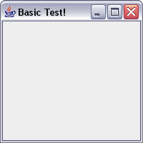
Creating a Window in Swing
import javax.swing.*;
public class Basic1 {
public static void main(String[] args) {
//create the window
JFrame f = new JFrame("Basic Test!");
//quit Java after closing the window
f.setDefaultCloseOperation(JFrame.EXIT_ON_CLOSE);
f.setSize(200, 200); //set size in pixels
f.setVisible(true); //show the window
}
}

Slide 12
Creating a Window Using a Constructor
import javax.swing.*;
public class Basic2 extends JFrame {
public static void main(String[] args) {
new Basic2();
}
public Basic2() {
setTitle("Basic Test2!"); //set the title
//quit Java after closing the window
setDefaultCloseOperation(EXIT_ON_CLOSE);
setSize(200, 200); //set size in pixels
setVisible(true); //show the window
}
}

Slide 13


A More Extensive Example
import javax.swing.*;
import java.awt.*;
import java.awt.event.*;
public class Intro extends JFrame {
private int count = 0;
private JButton myButton = new JButton("Push Me!");
private JLabel label = new JLabel("Count: " + count);
public Intro() {
setDefaultCloseOperation(EXIT_ON_CLOSE);
setLayout(new FlowLayout(FlowLayout.LEFT)); //set layout manager
add(myButton); //add components
add(label);
myButton.addActionListener(new ActionListener() {
public void actionPerformed(ActionEvent e) {
count++;
label.setText("Count: " + count);
}
});
pack();
setVisible(true);
}
public static void main(String[] args) {
try {
UIManager.setLookAndFeel(UIManager.getSystemLookAndFeelClassName());
} catch (Exception exc) {}
new Intro();
}
}

Slide 14
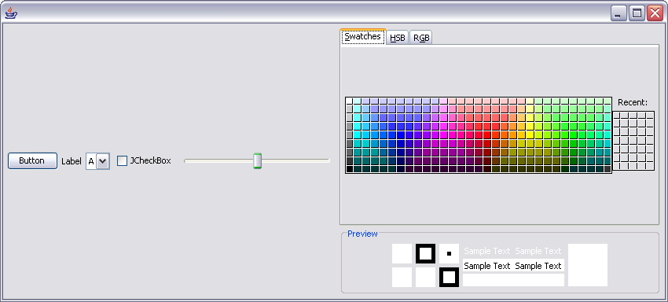
Component Examples
import javax.swing.*;
import java.awt.*;
public class ComponentExamples extends JFrame {
public ComponentExamples() {
setLayout(new FlowLayout(FlowLayout.LEFT));
add(new JButton("Button"));
add(new JLabel("Label"));
add(new JComboBox(new String[] { "A", "B", "C" }));
add(new JCheckBox("JCheckBox"));
add(new JSlider(0, 100));
add(new JColorChooser());
setDefaultCloseOperation(EXIT_ON_CLOSE);
pack();
setVisible(true);
}
public static void main(String[] args) {
try {
UIManager.setLookAndFeel(UIManager.getSystemLookAndFeelClassName());
} catch (Exception exc) {}
new ComponentExamples();
}
}

Slide 15
More Components
JFileChooser: allows choosing a file
JLabel: a simple text label
JTextArea: editable text
JTextField: editable text (one line)
JScrollBar: a scrollbar
JPopupMenu: a pop-up menu
JProgressBar: a progress bar
Lots more!

Slide 16
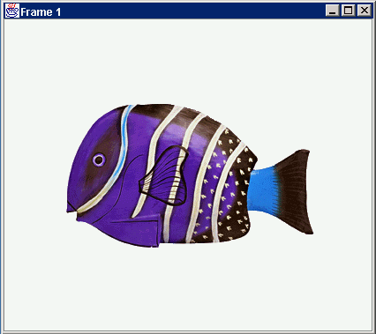
Application Code
import javax.swing.*;
class hello {
public static void main(String[] args){
JFrame f = new JFrame(“title”);
JPanel p = new JPanel();
JButton b = new JButton(“press me”);
p.add(b); // add button to panel
f.setContentPane(p); // add panel to frame
f.show();
}
}
press me

Slide 17
Containers
A container is a component that
Can hold other components
Has a layout manager
Heavyweight vs. lightweight
A heavyweight component interacts directly with the host system
JWindow, JFrame, and JDialog are heavyweight
Except for these top-level containers, Swing components are almost all lightweight
JPanel is lightweight
There are three basic top-level containers
JWindow: top-level window with no border
JFrame: top-level window with border and (optional) menu bar
JDialog: used for dialog windows
Another important container
JPanel: used mostly to organize objects within other containers

Slide 18
Layout
Issue here concerns the way the components are placed on the screen
If you do it statically (and you can), the resulting application can’t be resized easily
So GUI builders offer a more dynamic option

Slide 19
Layout Managers
A layout manager controls placement and sizing of components in a container
If you do not specify a layout manager, the container will use a default:
JPanel default = FlowLayout
JFrame default = BorderLayout
Five common layout managers: BorderLayout, BoxLayout, FlowLayout, GridBagLayout, GridLayout
General syntax
container.setLayout(new LayoutMan());
Examples:
JPanel p1 =
new JPanel(new BorderLayout());
JPanel p2 = new JPanel();
p2.setLayout(new BorderLayout());

Slide 20
Some Example Layout Managers
FlowLayout
Components placed from left to right in order added
When a row is filled, a new row is started
Lines can be centered, left-justified or right-justified (see FlowLayout constructor)
See also BoxLayout
GridLayout
Components are placed in grid pattern
number of rows & columns specified in constructor
Grid is filled left-to-right, then top-to-bottom
BorderLayout
Divides window into five areas: North, South, East, West, Center
Adding components
FlowLayout and GridLayout use container.add(component)
BorderLayout uses container.add(component, index) where index is one of
BorderLayout.NORTH
BorderLayout.SOUTH
BorderLayout.EAST
BorderLayout.WEST
BorderLayout.CENTER

Slide 21
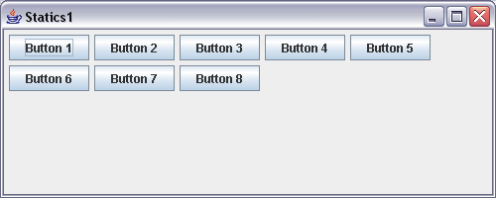
FlowLayout Example
import javax.swing.*;
import java.awt.*;
public class Statics1 {
public static void main(String[] args) {
new S1GUI();
}
}
class S1GUI {
private JFrame f;
public S1GUI() {
f = new JFrame("Statics1");
f.setDefaultCloseOperation(JFrame.EXIT_ON_CLOSE);
f.setSize(500, 200);
f.setLayout(new FlowLayout(FlowLayout.LEFT));
for (int b = 1; b < 9; b++)
f.add(new JButton("Button " + b));
f.setVisible(true);
}
}

Slide 22
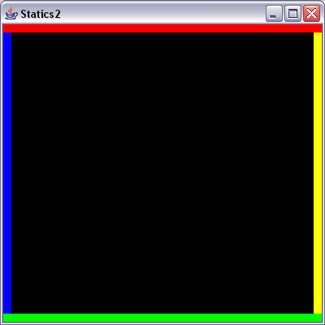
BorderLayout Example
import javax.swing.*;
import java.awt.*;
public class Statics2 {
public static void main(String[] args) { new S2GUI(); }
}
class ColoredJPanel extends JPanel {
Color color;
ColoredJPanel(Color color) {
this.color = color;
}
public void paintComponent(Graphics g) {
g.setColor(color);
g.fillRect(0, 0, 400, 400);
}
}
class S2GUI extends JFrame {
public S2GUI() {
setTitle("Statics2");
setDefaultCloseOperation(JFrame.EXIT_ON_CLOSE);
setSize(400, 400);
add(new ColoredJPanel(Color.RED), BorderLayout.NORTH);
add(new ColoredJPanel(Color.GREEN), BorderLayout.SOUTH);
add(new ColoredJPanel(Color.BLUE), BorderLayout.WEST);
add(new ColoredJPanel(Color.YELLOW), BorderLayout.EAST);
add(new ColoredJPanel(Color.BLACK), BorderLayout.CENTER);
setVisible(true);
}
}

Slide 23
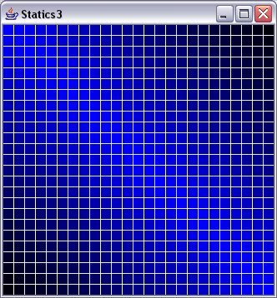
GridLayout Example
import javax.swing.*;
import java.awt.*;
public class Statics3 {
public static void main(String[] args) { new S3GUI(); }
}
class S3GUI extends JFrame {
static final int DIM = 25;
static final int SIZE = 12;
static final int GAP = 1;
public S3GUI() {
setTitle("Statics3");
setDefaultCloseOperation(EXIT_ON_CLOSE);
setLayout(new GridLayout(DIM, DIM, GAP, GAP));
for (int i = 0; i < DIM * DIM; i++) add(new MyPanel());
pack();
setVisible(true);
}
class MyPanel extends JPanel {
MyPanel() { setPreferredSize(new Dimension(SIZE, SIZE)); }
public void paintComponent(Graphics g) {
float gradient =
1f - ((float)Math.abs(getX() - getY()))/(float)((SIZE + GAP) * DIM);
g.setColor(new Color(0f, 0f, gradient));
g.fillRect(0, 0, getWidth(), getHeight());
}
}
}

Slide 24
More Layout Managers
CardLayout
Tabbed index card look from Windows
GridBagLayout
Most versatile, but complicated
Custom
Can define your own layout manager
But best to try Java's layout managers first...
Null
No layout manager
Programmer must specify absolute locations
Provides great control, but can be dangerous because of platform dependency

Slide 25
Famous GUI Builders (Java IDEs)
Netbeans (Sun)
JBuilder (Borland)
Eclipse (IBM and others)

